Slide 1
INTRODUCTION

Slide 2
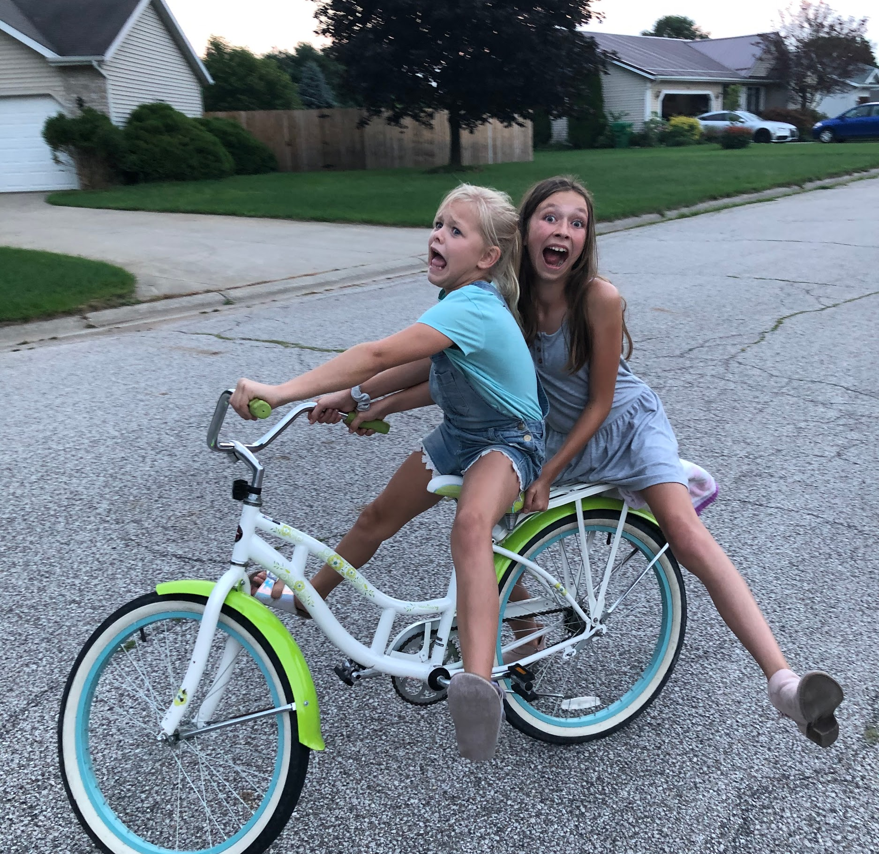
Welcome!
Parenting can be a wild ride! In this course, we will learn some tools that can help us to navigate the emotional bumps along the way. Today is the first step in changing your social interactions and building a healthier family dynamic.
Notes:
Pre Instructional: Confidence

Slide 3
Krystal
Licensed Child Play Therapist
Notes:
Pre Instructional: Provide for Motivation

Slide 4
INCREASE OUR EMOTIONAL INTELLIGENCE (EQ) TO BE MORE EFFECTIVE PERSONALLY, INTERPERSONALLY, AND SOCIALLY, ESPECIALLY AT HOME WITH LOVED ONES
OUR COURSE GOAL

Slide 5
Emotional intelligence (EQ) is the ability to monitor one’s own and other’s feelings and emotions, to distinguish between them, and to use this information to guide one’s thinking and actions.

Slide 6
How we’ll do it: The RULER method
RULER is an evidence-based approach to social and emotional learning (SEL) that supports children, parents, teachers, schools, and the community in:
• Understanding the value of emotions
• Building the skills of emotional intelligence
• Creating and maintaining a positive climate at school and at home
It was developed by the Yale Center for Emotional Intelligence. Marc Brackett, Ph.D. (right) is the director of the Center.
Brackett has been awarded the Joseph E. Zins Award, is a scientist on the National Commission on Social, Emotional, and Academic Development, is a member of the board of directors for the Collaborative for Academic, Social, and Emotional Learning, and has published over 100 scholarly articles (Brackett, 2020).
Image by: “Marc Brackett.” Yale Center for Emotional Intelligence, Yale University Center for Emotional Intelligence, 2020, www.ycei.org/marc-brackett.
Notes:
Pre Instructional: Relevance

Slide 7
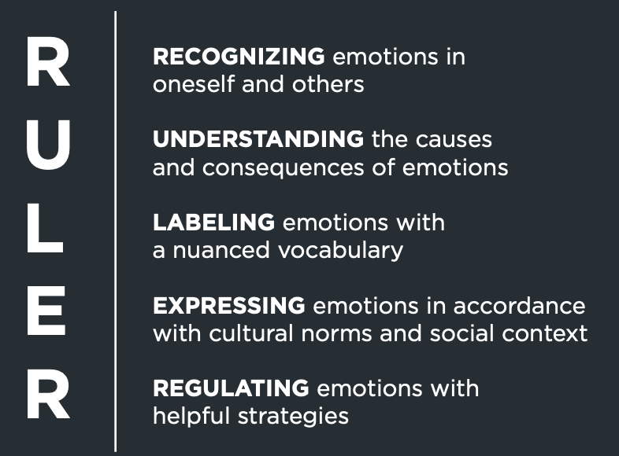
RULER?
Notes:
Pre Instructional: Relevance

Slide 8
The promise of RULER
Research shows that RULER skills help people of all ages to use emotions wisely.
That includes millions of students, teachers, and parents like you.
We believe RULER can help you create the emotional climate you want at home with your family.

Slide 9
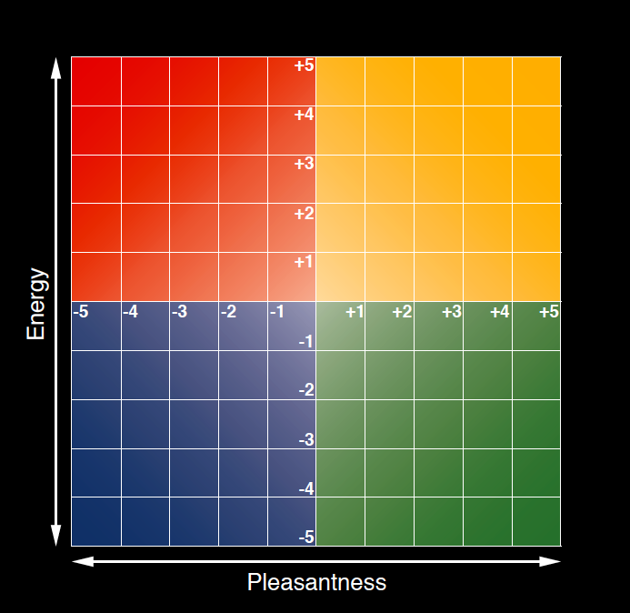
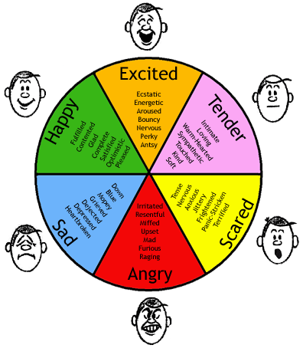
Two important tools
Mood Meter
Feeling Word List

Slide 10
Before we dive in
Who are you?
Tell us a bit about your family.
How are you feeling?
How do you think of when you hear “emotions?”
How do you navigate emotions in others and in yourself?

Slide 11
RULER Self-Assessment
[Still waiting on this - link to be inserted once we get sign off from CEI]
Part 1 to assess willingness/attitude.
Part 2 to assess ability/verbal and intellectual skills.

Slide 12
Family Member Assessment
[Still waiting on this - to be based off of self-assessment]
Family members will complete this periodically throughout the course for you to get an external view of how you are progressing.

Slide 13
Technology assessment
[INSERT from CAPS]

Slide 14
What you will learn:
Recognize Emotions Arising in Yourself and Others
Notes:
Pre Instructional: Inform Learner of Objectives

Slide 15
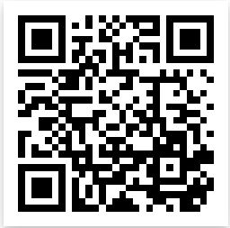
Use the QR Code or click on the link to go to our discussion padlet to post your answer.
What do you think?
Explain the link between understanding the causes of emotions and being able to properly label them.
https://padlet.com/wagneere/mta6xksjs5a0gsax
Notes:
Pre Instructional: Link new content to existing knowledge/skills

Slide 16
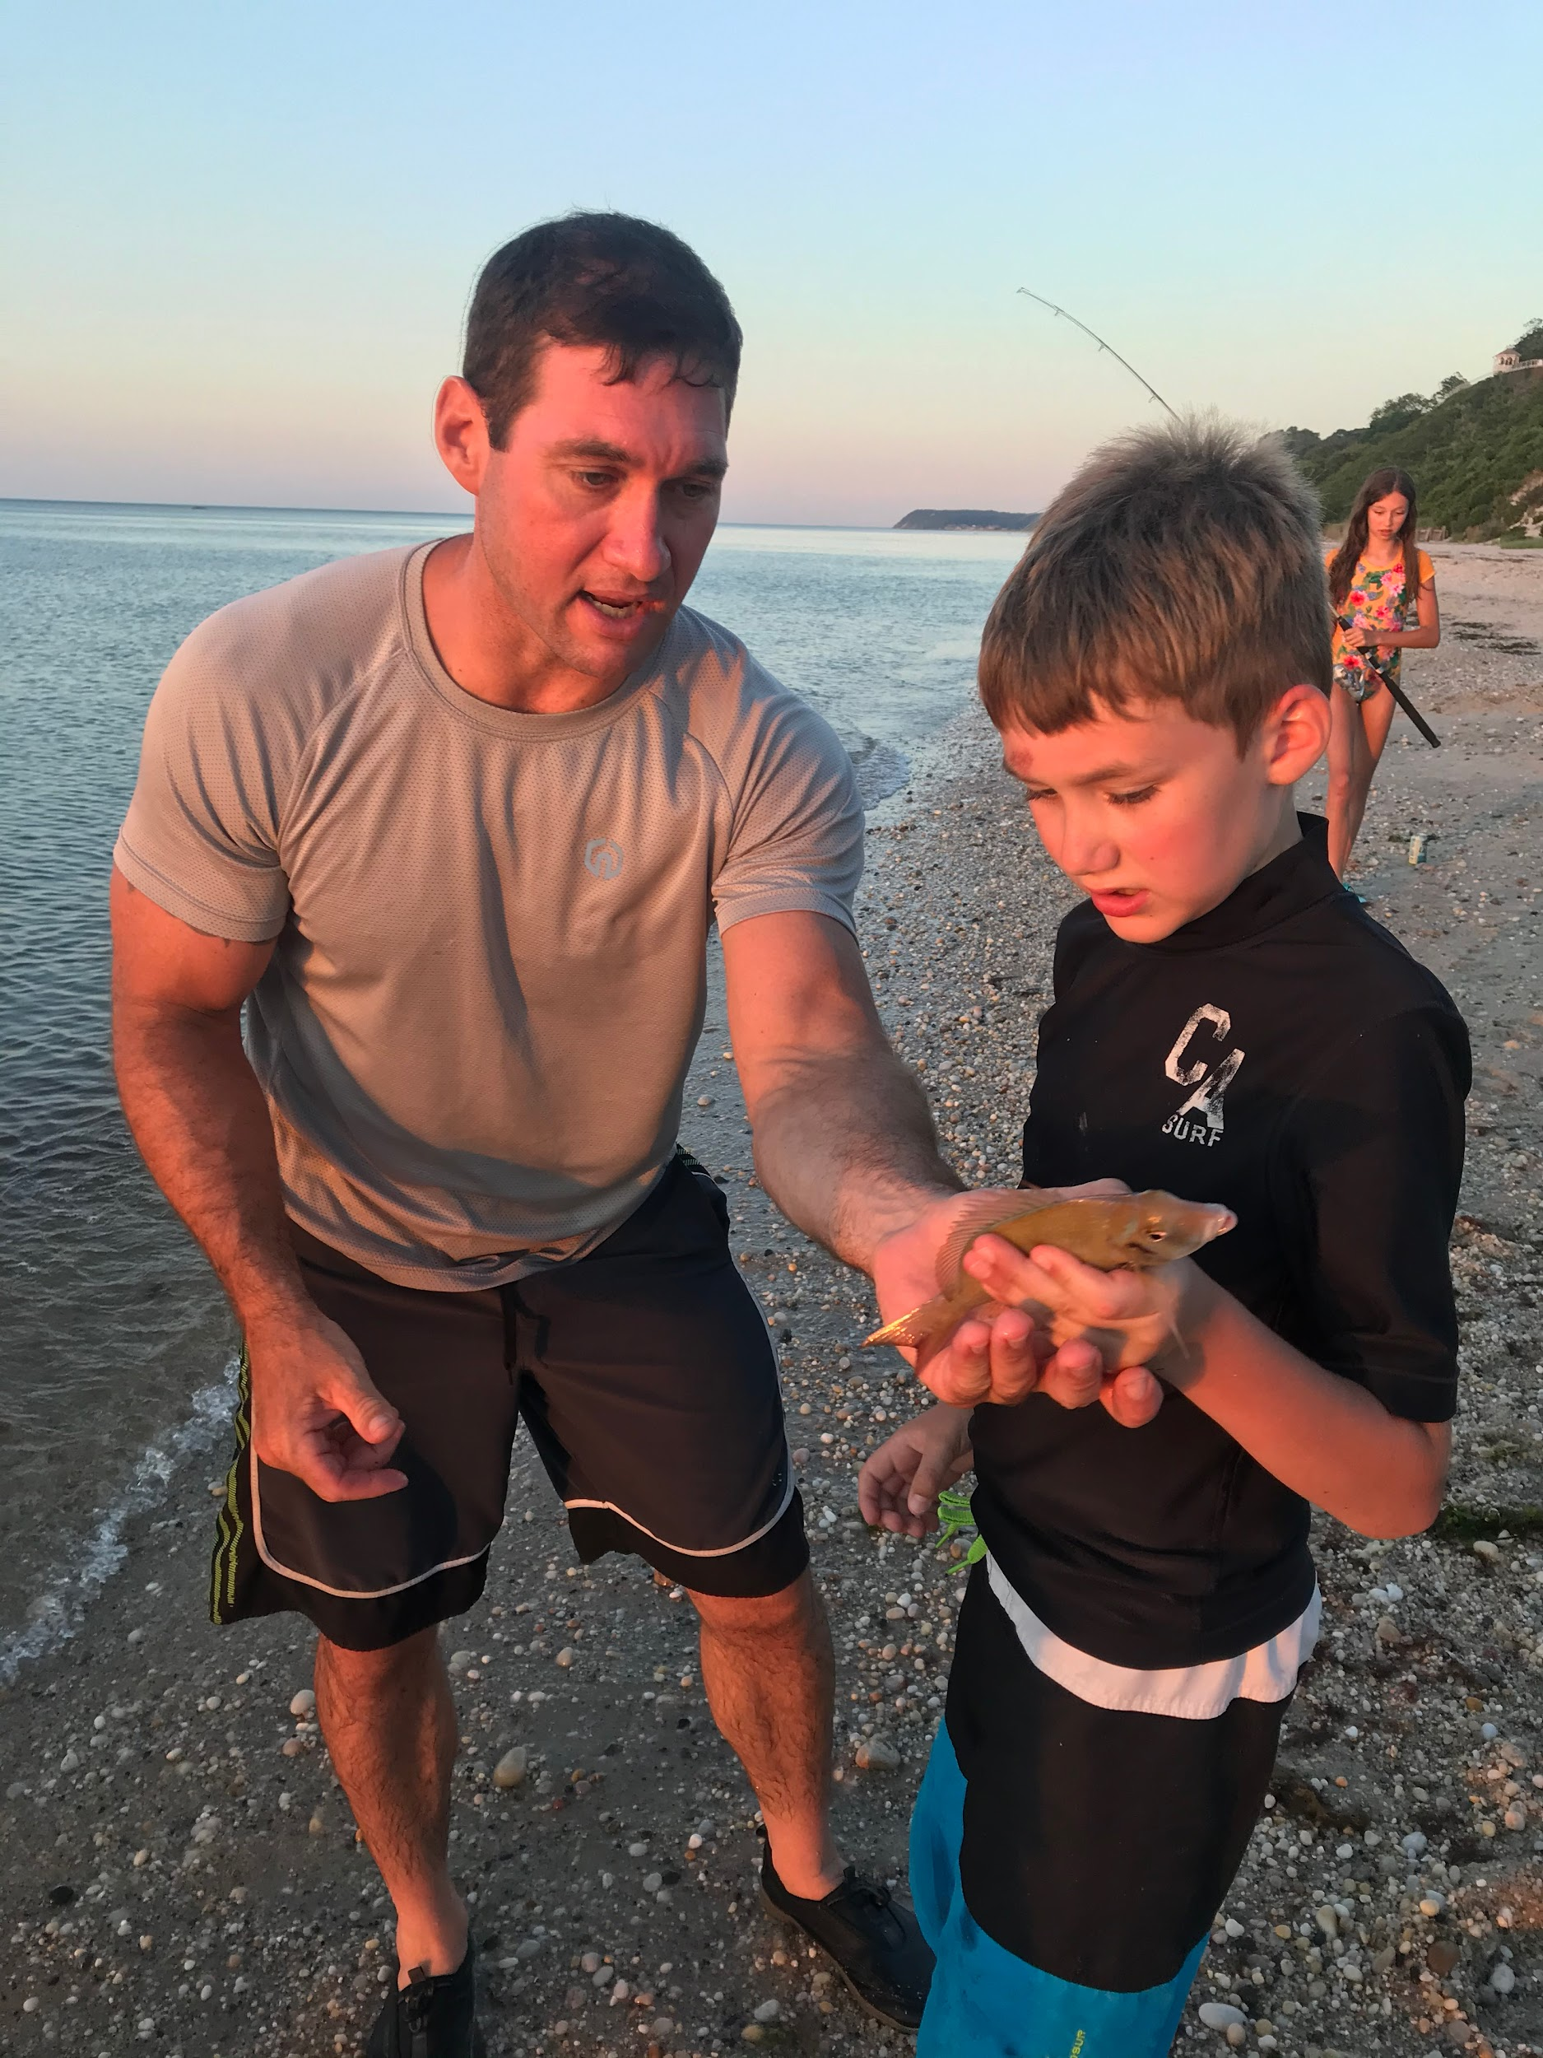
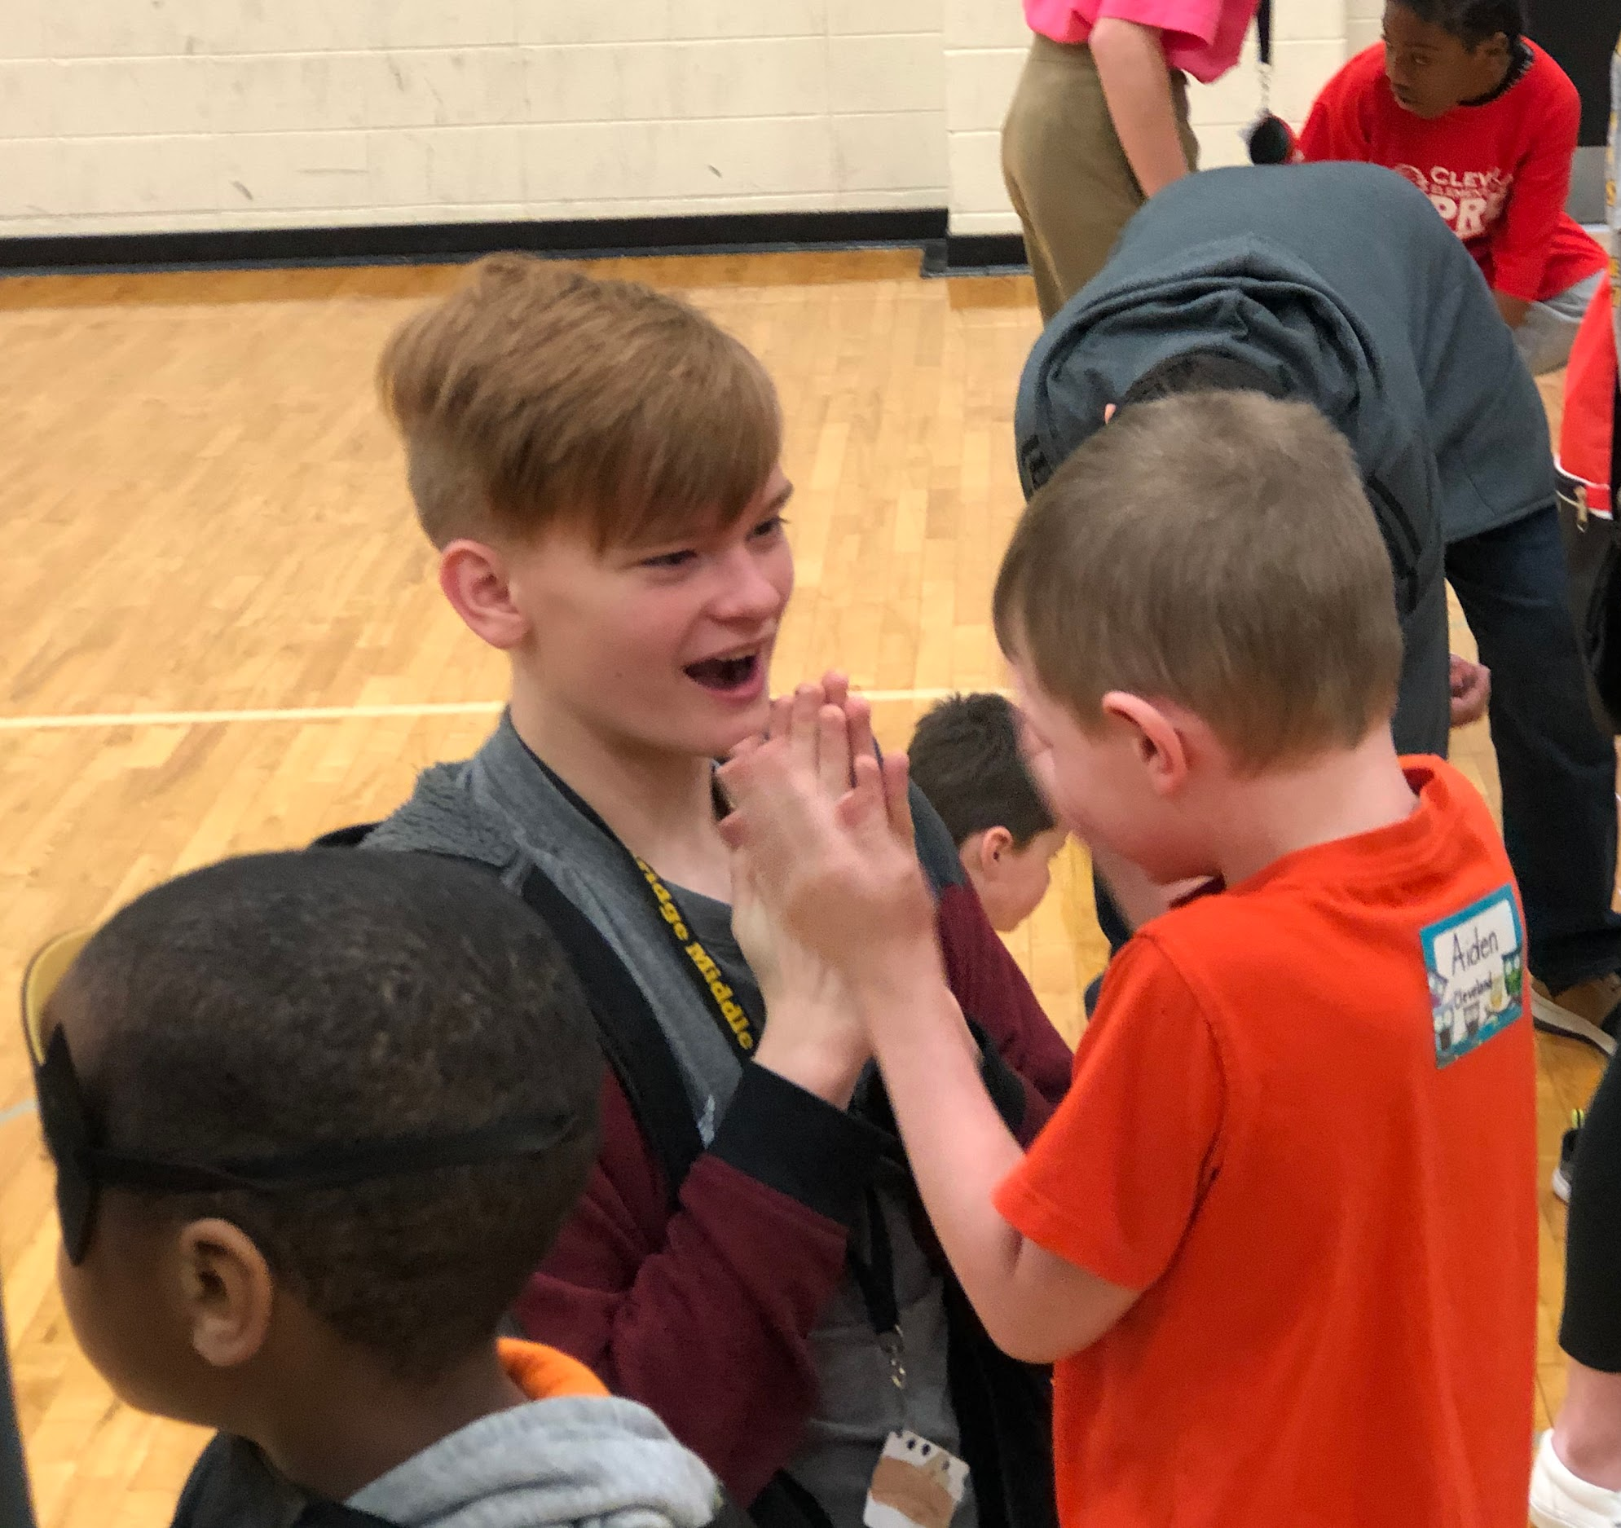
Can you interpret the feeling word associated with the following images?
Notes:
Content Presentation and Learner Guidance: Disclose distinguishing characteristics of concepts
Explain basic feeling words and match these words to descriptions of those feelings using text and images.(3.1a)

Slide 17
Check your understanding
Click HERE for the link
How Did you Do?
See if you can accurately match the feeling words with the facial expression and body posture.
The google form will give you a score after you finish.
Remember the parts of this that were easy or difficult so we can discuss them at our next group meeting.
Notes:
Provide a list of feeling words and ask learners to match each feeling word to the corresponding facial expression and body posture (3.1b)

Slide 18
A teenage boy shows his report card to his dad. The grades are well below what his father expected. The dad starts questioning the boy about his study habits.
What emotions could be arising for the dad?
What about for the boy?

Slide 19
There are several factors that could give us clues to how the father and son are each feeling.
What was the tone used by the father?
Does the boy have a history of poor grades?
Does the boy need some extra interventions to succeed?
What nonverbal clues were they giving off?

Slide 20
References
“Marc Brackett.” Yale Center for Emotional Intelligence, Yale University Center for Emotional Intelligence, 2020, www.ycei.org/marc-brackett.

Slide 21
Credits
Special thanks to all the people who made and released these awesome resources for free:
Presentation template by SlidesCarnival
Photographs by Unsplash

