Slide 1
Evaluation Presentation – The Feeling Good Institute
Patrick Healy
R561
Winter/Spring 2021
Notes:
For my R561 evaluation project, I continued working on the training and certification redesign that I began in Fall 2020 for The Feeling Good Institute (FGI). This presentation summarizes the evaluation conducted during Phase II of the project in Winter/Spring 2021.

Slide 2
Roadmap
Introduction and Purpose
Evaluation Methodology
Preliminary Findings
Tentative Recommendations

Slide 3
I. Introduction & Purpose

Slide 4
I. Introduction & Purpose
The Organization/Client
Context for Evaluation
Purpose of Evaluation
Targets of Evaluation
Notes:
In this section, I provide a brief overview of the FGI organization, offer useful background and context for evaluation, define the purpose of the evaluation, and describe the training offering and therapist certification process that were the two main objects of this evaluation.

Slide 5
I. Introduction & Purpose
The Organization/Client
Context for Evaluation
Purpose of Evaluation
Targets of Evaluation

Slide 6
The Organization
The Feeling Good Institute (FGI) is a treatment center based in Mountain View, CA that specializes in providing patients with intensive cognitive-behavioral therapy (CBT) to help them feel good.
FGI also trains therapists in advanced techniques to enhance their skills and help them achieve improved clinical outcomes with their clients.
Source: FGI website

Slide 7
The Organization
Founding
FGI was founded in 2014 by a group of master clinicians in “TEAM-CBT,” a highly effective framework for providing CBT developed by Dr. David D. Burns.
FGI Founding Team
Dr. David D., Burns, creator of TEAM Therapy
Source: FGI website

Slide 8
TEAM?
Testing
Measurement of the patient’s symptoms, feelings, and impression of the therapist before/after sessions
Empathy
Skills designed to help the therapist establish a warm therapeutic alliance with each patient
Agenda Setting/Assessment of Motivation
Tools to develop a collaborative agenda with the patient on therapy goals and increase motivation/reduce resistance to change
Methods
Application of a range of cognitive and behavioral methods to address different types of symptoms
Source: FGI website
Notes:
TEAM-CBT is a transdiagnostic framework for conducting evidence-based therapy that includes four elements known to be related to positive treatment outcomes:
T = Testing: Self-report measurement of symptoms and the therapeutic alliance at every session with every patient
E = Empathy: Specific skills to help the therapist establish a warm therapeutic alliance and address alliance ruptures with each patient before proceeding to CBT Methods
A = Agenda Setting: Numerous tools to create a collaborative agenda with each patient and address motivation/reduce resistance to change before proceeding to CBT methods
M = Methods: 50+ cognitive and behavioral methods for different types of symptoms

Slide 9
CBT?
Thoughts
Behaviors
Therapeutic Change
Feelings
Cognitive-Behavioral Therapy

Slide 10
The Organization
Three Missions
As a treatment center, FGI seeks to provide better therapy for patients seeking tools for change.
As a research institute dedicated to the study and practice of TEAM therapy, FGI seeks to expand the reach and impact of its framework and tools around the globe.
As a training organization, FGI seeks to help therapists become more successful practitioners by providing training in advanced CBT skills and offering a supportive, collaborative, and engaging community.
Source: FGI website

Slide 11
The Organization
Leadership
Source: FGI website

Slide 12
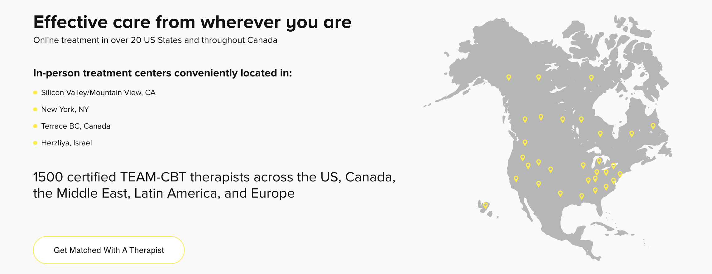
The Organization
Scale
Notes:
As of April 2021, FGI also has sister offices in New York City, Canada, and Israel and offers online therapy to clients in over twenty U.S. states. A growing network of 1500+ clinicians provide TEAM-CBT therapy and coaching services to clients in over two dozen countries. 50+ Level 4 and 5 master clinicians are certified to train therapists in TEAM across the globe.

Slide 13
The Organization
Therapist Education
In-person and online training offerings and certification services to therapists with all levels of experience.
Source: FGI website

Slide 14
Organizations
Offerings include:
Live and pre-recorded webinars
Day-long and multi-day workshops and intensives Live online multi-week TEAM-CBT training programs
Face-to-face and online TEAM-CBT courses for beginning, intermediate, and advanced level clinicians seeking certification
An Advanced TEAM-CBT Training course towards Level 3 certification (ATC)
Weekly case consultation groups for therapists
Weekly skills practice groups
One-off local training courses (by office)
Source: FGI website

Slide 15
I. Introduction & Purpose
The Organization/Client
Context for Evaluation
Purpose of Evaluation
Targets of Evaluation

Slide 16
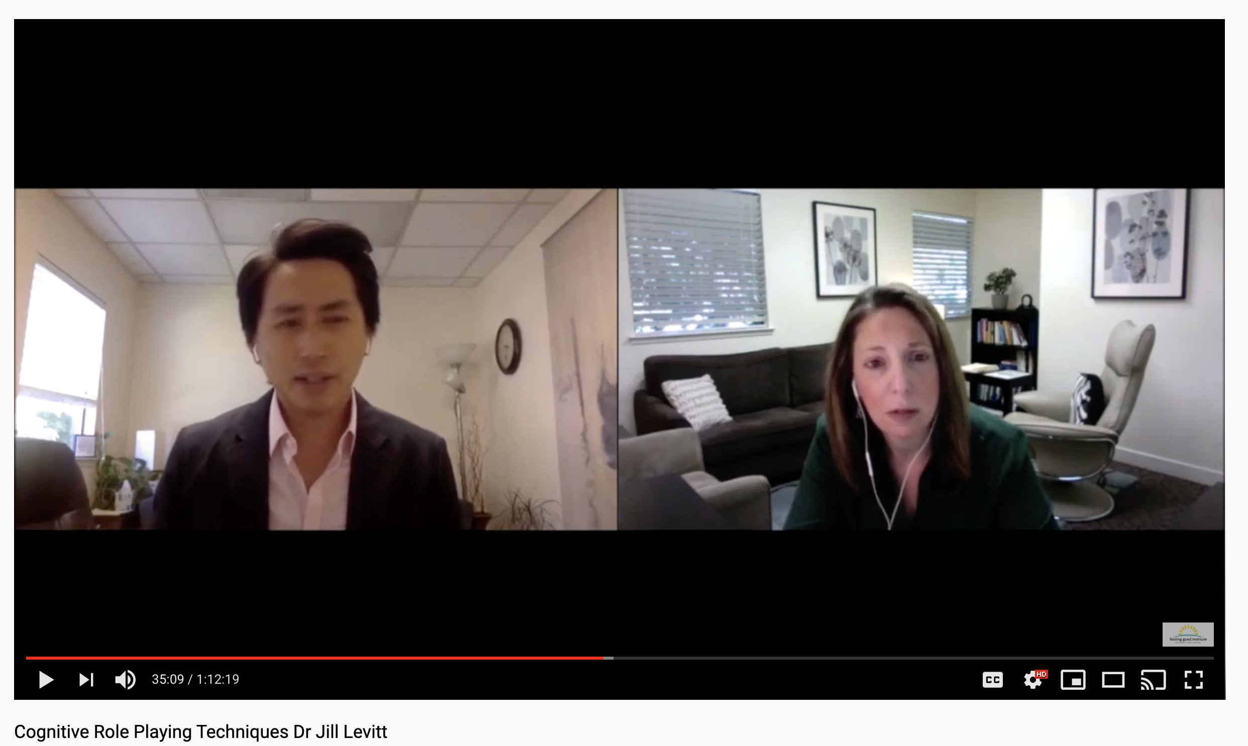
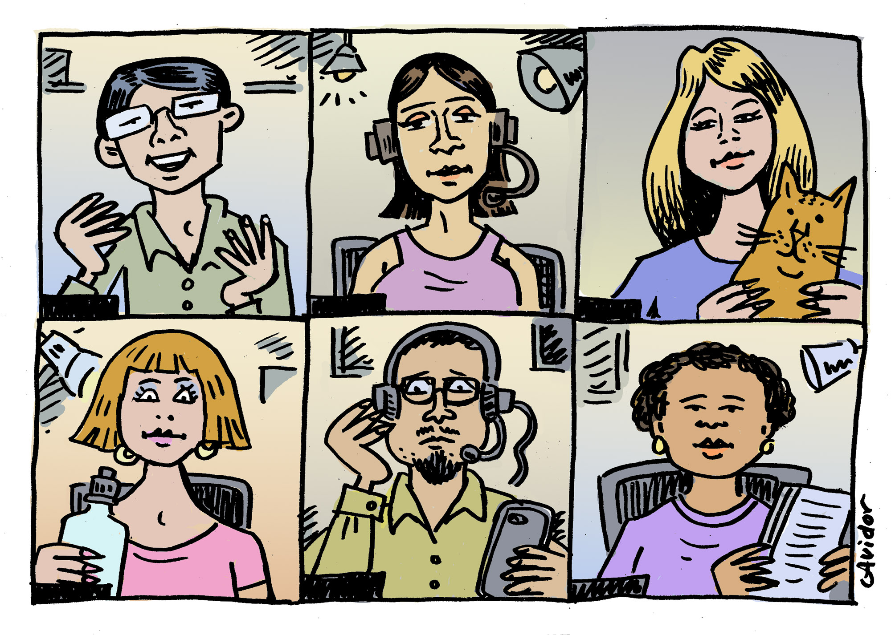
Context for Evaluation
Life of a Therapist
Performance Context
Therapists work with a wide range of clients with a diverse array of symptoms and presenting problems, individually or in groups, face to face or via telehealth
Learning Context
Online courses and webinars
Continuing education workshops
Consultation groups to discuss clinical problems of practice and try out new techniques

Slide 17
Context for Evaluation
FGI TEAM Certification
Certification is intended to provide quality training to clinicians interested in providing TEAM therapy to their clients
It involves 5 levels of skill development and application:
L1-Beginning TEAM Therapist
L2- Intermediate TEAM Therapist
L3 – Advanced TEAM Therapist
L4 – TEAM Trainer
L5 – TEAM Master
L0 - Novice
Level 3 Oral Skills Exam
Source: FGI website
Notes:
Level 3: the level at which such therapists are skilled enough to begin practicing it independently, serving as mentors for other aspiring TEAM therapists, and generally expanding the reach of TEAM through their own centers across the U.S. and the world.
TEAM-CBT certification
There are five levels of TEAM-CBT certification.
Certification serves as a roadmap to help you advance your skills in TEAM therapy. Certification is intended to provide quality training to clinicians interested in providing TEAM therapy and to publicly acknowledge those who have received training. We would love to welcome you to the TEAM community and support your learning! Five progressive Certification levels provide opportunities for clinicians to deepen their level of skill mastery. Certification can be accomplished through participation in various types of training (e.g., online or local group training, individual training, workshops, self-study). Please download the Certification Requirements & Units Table to learn details.

Slide 18
Context for Evaluation
Advanced Training
12-week comprehensive course designed to help clinicians level up their TEAM skills enough to pass the Level 3 exam and become certified.
L1-Beginning TEAM Therapist
L2- Intermediate TEAM Therapist
L3 – Advanced TEAM Therapist
L4 – TEAM Trainer
L5 – TEAM Master
L0 - Novice
Level 3 Oral Skills Exam
Advanced Training course towards Level 3 certification (ATC)
Source: FGI website
Notes:
Advanced Training Course (ATC)
The Advanced TEAM-CBT Training Course Towards Level 3 Certification (“Advanced Training Course” or “ATC”) is a 12-week live interactive online course designed to help clinicians with some background in TEAM-CBT master their skills to the level of Level 3 TEAM-CBT certification. The class format includes didactic training, live demonstrations, and role-play practice exercises with opportunities for feedback throughout. The course is ideal for (but not limited to) therapists preparing for the TEAM-CBT level 3 skills verification interview (known as the oral exam).

Slide 19
Context for Evaluation
Problem(s):
Inefficient process and unreliable clinical skills exam
Questionable training quality/effectiveness
Not set up to scale
L1-Beginning TEAM Therapist
L2- Intermediate TEAM Therapist
L3 – Advanced TEAM Therapist
L4 – TEAM Trainer
L5 – TEAM Master
L0 - Novice
Level 3 Oral Skills Exam
Advanced Training course towards Level 3 certification (ATC)
Source: FGI website
Notes:
Level 3: the level at which such therapists are skilled enough to begin practicing it independently, serving as mentors for other aspiring TEAM therapists, and generally expanding the reach of TEAM through their own centers across the U.S. and the world.

Slide 20
Context for Evaluation
Previous Work with FGI
Fall 2020: Reviewed FGI’s existing ATC and certification process to identify strengths, weaknesses, and provide recommendations
Winter 2021: Implemented initial round of revisions to ATC and certification process
Spring 2021: Evaluation of impact of revisions

Slide 21
Context for Evaluation
Fall 2020 Findings
Strengths:
high-quality ATC content and activities
a strong sense of community amongst FGI participants
knowledgeable, skilled, and dedicated trainers
extremely high participant satisfaction to date in the ATC
some evidence of successful application of skills in the therapist performance context
Notes:
Phase I Findings & Recommendations
The needs assessment revealed several positives and strengths with FGI’s existing training program and certification process, including:
high-quality ATC content and activities
a strong sense of community amongst FGI participants
knowledgeable, skilled, and dedicated trainers
extremely high participant satisfaction to date in the ATC
some evidence of successful application of skills in the therapist performance context
However, the assessment also revealed several weaknesses and opportunities for improvement, namely:
a long and confusing certification process, as noted by multiple stakeholders
significant time, resources, and energy required for participants to become certified
an opportunity to provide trainers and participants with additional guidance in training and job aids in their performance context
low bandwidth of FGI leaders and trainers to revise content and offer exams
inadequate evaluation methods for measuring the impact of training
Taken together, these findings suggested a very well-received training course with much learning and some evidence of application, but an unreliable, inefficient, and unscalable training program and certification process, unlikely to facilitate the organization’s goal of expanding its reach in 2021 and beyond.
Based on these findings, my recommendations to the organization included:
simplifying and clarifying the certification process to increase efficiency and revise the Level 3 certification exam to produce more reliably skilled therapists
adopting a more rigorous training evaluation process to measure the impact of training (and training revisions) on participant and organizational outcomes
developing additional training and performance support materials to target Kirkpatrick Level 3 and 4 measures of interest
incorporating new technologies to allow for greater efficiencies and scale in future iterations of training
Revisions Implemented
In Winter 2021 I worked with FGI leadership, trainers, and administrators to put in place some of the above recommendations, including:
simplifying and clarifying the certification process
adopting a new learning management system (TalentLMS) to allow for easier participant enrollment, certification management, and training evaluation
revising post-session and post-program surveys
developing additional trainer and participant templates and instructions for use in training
creating additional participant job aids for use in their own clinical practices
revising the L3 skills exam rubric to be more objective and improve inter-rater reliability

Slide 22
Context for Evaluation
Fall 2020 Findings
Weaknesses/Opportunities:
long and confusing certification process
significant time, resources, and energy required for participants to become certified
an opportunity to provide trainers and participants with additional guidance in training and job aids in their performance context
low bandwidth of FGI leaders and trainers to revise content and offer exams
inadequate evaluation methods for measuring the impact of training
Notes:
Based on these findings, my recommendations to the organization included:
simplifying and clarifying the certification process to increase efficiency and revise the Level 3 certification exam to produce more reliably skilled therapists
adopting a more rigorous training evaluation process to measure the impact of training (and training revisions) on participant and organizational outcomes
developing additional training and performance support materials to target Kirkpatrick Level 3 and 4 measures of interest
incorporating new technologies to allow for greater efficiencies and scale in future iterations of training
Revisions Implemented
In Winter 2021 I worked with FGI leadership, trainers, and administrators to put in place some of the above recommendations, including:
simplifying and clarifying the certification process
adopting a new learning management system (TalentLMS) to allow for easier participant enrollment, certification management, and training evaluation
revising post-session and post-program surveys
developing additional trainer and participant templates and instructions for use in training
creating additional participant job aids for use in their own clinical practices
revising the L3 skills exam rubric to be more objective and improve inter-rater reliability

Slide 23
Context for Evaluation
Fall 2020 Recommendations
simplify and clarify the certification process to increase efficiency and revise the Level 3 certification exam to produce more reliably skilled therapists
adopt a more rigorous training evaluation process to measure the impact of training (and training revisions) on participant and organizational outcomes
develop additional training and performance support materials to target Kirkpatrick Level 3 and 4 measures of interest
incorporate new technologies to allow for greater efficiencies and scale in future iterations of training
Notes:
Phase I Findings & Recommendations
The needs assessment revealed several positives and strengths with FGI’s existing training program and certification process, including:
high-quality ATC content and activities
a strong sense of community amongst FGI participants
knowledgeable, skilled, and dedicated trainers
extremely high participant satisfaction to date in the ATC
some evidence of successful application of skills in the therapist performance context
However, the assessment also revealed several weaknesses and opportunities for improvement, namely:
a long and confusing certification process, as noted by multiple stakeholders
significant time, resources, and energy required for participants to become certified
an opportunity to provide trainers and participants with additional guidance in training and job aids in their performance context
low bandwidth of FGI leaders and trainers to revise content and offer exams
inadequate evaluation methods for measuring the impact of training
Taken together, these findings suggested a very well-received training course with much learning and some evidence of application, but an unreliable, inefficient, and unscalable training program and certification process, unlikely to facilitate the organization’s goal of expanding its reach in 2021 and beyond.
Based on these findings, my recommendations to the organization included:
simplifying and clarifying the certification process to increase efficiency and revise the Level 3 certification exam to produce more reliably skilled therapists
adopting a more rigorous training evaluation process to measure the impact of training (and training revisions) on participant and organizational outcomes
developing additional training and performance support materials to target Kirkpatrick Level 3 and 4 measures of interest
incorporating new technologies to allow for greater efficiencies and scale in future iterations of training
Revisions Implemented
In Winter 2021 I worked with FGI leadership, trainers, and administrators to put in place some of the above recommendations, including:
simplifying and clarifying the certification process
adopting a new learning management system (TalentLMS) to allow for easier participant enrollment, certification management, and training evaluation
revising post-session and post-program surveys
developing additional trainer and participant templates and instructions for use in training
creating additional participant job aids for use in their own clinical practices
revising the L3 skills exam rubric to be more objective and improve inter-rater reliability

Slide 24
Context for Evaluation
Winter 2021 Revisions
simplified and clarified communications around the certification process
revised the L3 oral skills exam rubric to include more objective language
developed new and revised course materials for use in training
created additional participant job aids for use in their own clinical practices
adopted a new learning management system (TalentLMS)
revised post-session and post-program surveys

Slide 25
Context for Evaluation
I – FALL 2020/WINTER 2021
II – WINTER/SPRING 2021
III – SPRING/SUMMER 2021
Needs Assessment/Analysis
Interview Stakeholders
Provide Initial Recommendations to Improve February 2021 Advanced Training Course (ATC)
Implement Phase I Recommendations
Audit Training Course + Formative Evaluation
Summative Evaluation of Spring 2021Program
Implement Phase II Recommendations
Data Analysis
Post-Program Survey
Participant Interviews
Conduct 3-Month Follow-Up Survey with Participants to Gauge Kirkpatrick Level 3 Application
Review Existing Content & Prior Training Data
Analyze Data and Provide Recommendations
We are Here

Slide 26
I. Introduction & Purpose
The Organization/Client
Context for Evaluation
Purpose of Evaluation
Targets of Evaluation

Slide 27
Targets of Evaluation
Advanced Training Course (ATC)
Quality
Certification Process
Efficiency
Reliability
Scalability

Slide 28
II. Evaluation Methodology

Slide 29
II. Evaluation Methodology
Key Questions
Participants
Data Sources
Data Collection & Analysis
Notes:
In this section, I lay out the questions that the evaluation sought to answer, describe the target audience for the evaluation, discuss the sources from which evaluation data were gathered, and explain the processes through which data were collected and analyzed to answer the evaluation questions of interest.

Slide 30
II. Evaluation Methodology
Key Questions
Participants
Data Sources
Data Collection & Analysis

Slide 31
Key Evaluation Questions
ATC
To what extent did changes to the ATC impact key Kirkpatrick Level 1, 2, 3, and 4 indicators of interest?
New and improved course materials and procedures?
The new learning management system (TalentLMS)?
Did revised survey instruments provide FGI better training evaluation data than did their previous instruments?

Slide 32
Key Evaluation Questions
Certification Process
To what extent did/will participants find the revised certification process and skills exam easier to navigate?
To what extent did/will the revised Level 3 certification exam rubric yield qualified TEAM-CBT certified therapists with greater reliability?
To what extent did/will the implementation of the new LMS make the training and certification process more efficient and scalable?

Slide 33
II. Evaluation Methodology
Key Questions
Participants
Data Sources
Data Collection & Analysis

Slide 34
Participants
ATC Spring 2021Participants
42 licensed mental health professionals (i.e., MDs, psychologists, social workers, etc.) working in a wide range of settings across the U.S., Canada, and other countries
All possessed some background knowledge and skill in TEAM-CBT (Level 1)
All were committed to advancing their TEAM-CBT skills quickly to become Level 3 certified via training (highly motivated bunch!)

Slide 35
II. Evaluation Methodology
Key Questions
Participants
Data Sources
Data Collection & Analysis

Slide 36
Data Sources
4 Main Sources
Training Audit
Weekly Post-Session Feedback Surveys
Comprehensive Post-Program Evaluation
End-of-Course Participant Interviews
Notes:
Data was collected from several sources during Winter/Spring 2021. Sources included:
Real-time observation/audit of the Spring 2021 ATC by the author (weekly)
Revised post-session formative feedback forms filled out by participants online (weekly during the course)
A revised post-program summative evaluation survey filled out by participants online (end-of-course)
Interviews with program participants conducted by the author to gather qualitative data on their experiences in the program
Additional data will be collected from program participants in the future via a 3-month follow-up survey of participants to gauge application of learnings on-the-job and the impact of changes on their experience taking the Level 3 certification exam. It will be important in the future to also gather data on the number of therapists enrolling in the ATC, the number that sign up for the Level 3 exam, and percentage that pass the exam at the revised standard of quality to better determine the impact of process changes on efficiency, reliability, and scale.

Slide 37
II. Evaluation Methodology
Key Questions
Participants
Data Sources
Data Collection & Analysis

Slide 38
Data Collection & Analysis
Training Audit
Observed weekly training sessions from February-April 2021 over Zoom
Goal: assess how participants were engaging with revised course materials and the new course platform and see how trainers were implementing them
Process:
Jotted down questions that participants asked and took detailed for trainers for feedback
Joined breakout groups with participants to determine how well groups of participants were able to understand and utilize the materials
Met with trainers to assess how they thought the session went and troubleshoot issues they had
catalogued my notes into a master folder at the end of each session; analyzed using coding scheme I had developed in an earlier phase of the project to look for trends
Notes:
Audit
I audited the Winter/Spring 2021 ATC from February 2021 to April 2021 to assess how FGI staff were implementing Phase I changes and how participants were receiving them. During each week, I took notes on how trainers were presenting revised materials and how participants seemed to be engaging with them. I jotted down questions that participants asked and joined breakout groups with participants myself to determine how well groups of participants were able to understand and utilize the materials. After each session, I also met with trainers to assess how they thought the session went and troubleshoot issues they had. At the end of each session, I catalogued my notes into a master folder for later analysis. To analyze these notes, I used the same coding scheme as in Phase I of the project. See Appendix I for the coding scheme.

Slide 39
Data Collection & Analysis
Post-Session Feedback Forms
Delivered weekly from February-April 2021 immediately post-session
Goal: assess how participants were perceiving training, gather feedback to improve individual sessions, cement learning on weekly topics
Process:
Delivered via TalentLMS course platform
Surveys mostly qualitative to find out what was working and what was not; a few L1 quantitative (satisfaction, NPS)
Participants reminded at the end of each session
Notes:
Feedback Forms
After each weekly session of the ATC, participants were asked to fill out a short feedback form online on TalentLMS asking them what they thought about that session, what they liked and didn’t like, and a few topical questions to help cement their learning. These forms served as useful pulse checks each week to help the course team correct for errors and cater to participant needs the next session

Slide 40
Data Collection & Analysis
Post-Program Evaluation
Delivered immediately post-program in late April 2021
Goal: assess satisfaction, learning, and motivation to apply skills in their clinical practice going forward
Process:
At end of course, participants were asked to complete a more comprehensive summative evaluation online via GoogleForms to provide more substantial feedback on their program experience
Combination of quantitative and qualitative questions adapted from Kirkpatrick & Kirkpatrick (2016) to make sense for therapist context
Notes:
After the ATC ended in late April 2021, participants were asked to complete a longer summative evaluation online on TalentLMS to provide more substantial feedback on their overall experience in the course and reflect, what they learned, and how they might apply it going forward. Greatly informed by Kirkpatrick & Kirkpatrick (2016), this survey aimed to measure key Level 1 to 4 program measures. See Appendix H for a consolidated list of specific summative evaluation questions participants were asked at the end of the 12-week course.

Slide 41
Data Collection & Analysis
Participant Interview(s)
Conducted at the end of the program in April 2021over Zoom
Goal: assess how individual participants experienced the program in greater depth
Process:
Three participants were selected based on expressing interest on the end-of-course program evaluation
Interviews were semi-structured, lasting between 30-60 minutes each
Questions consisted of common questions and participant-specific ones based on feedback
Data analyzed using same coding scheme
Notes:
Finally, over the course of a week at the end of April 2021, I conducted three semi-structured interviews with Winter/Spring 2021 ATC program participants. Participants were selected based on expressing interest on the end-of-course program evaluation. Each interview took place via Zoom at a time convenient for the interviewee and lasted 30-60 minutes. Interviews were audio-recorded for me to later double check what I heard.
Common goals for all interviews included:
Better understanding the motivations of these stakeholders in engaging with the course, the TEAM certification process, and FGI as an organization.
Determining what they believed to be strengths and weaknesses of the training and certification process.
Hearing about their experience with select new ATC elements, especially the LMS.
Hearing their ideas for how the training and certification process might be improved.
To analyze the interview data, I added all my interview notes to a single document so that I could group like notes together by tag and identify key themes. To analyzing the notes, I used the same coding scheme as for analysis of my course notes.

Slide 42
III. Findings (Preliminary)

Slide 43
III. Findings (Preliminary)
Impact of Changes to Training
Impact of Changes to Certification Process

Slide 44
III. Findings (Preliminary)
Impact of Changes to Training
Impact of Changes to Certification Process

Slide 45
Impact of Changes to the ATC
Level 1 Reaction – VERY encouraging
FGI Winter/Spring 2021 Advanced Training Course End-of-Course Participant Reaction (n=27)
Q: “On a scale of 1 (strongly disagree) to 7 (strongly agree), with 4 being neither agree nor disagree, please indicate the extent to which you agree with the following statements related to your recent training program:”
Notes:
Level 1 Reaction
Table 1 below provides quantitative data from the post-program evaluation on participant impressions of training. As one can see, respondents were wildly satisfied with the course overall, rating it a 6.9/7. Participants also found it to be a highly engaging experience, one that facilitated their learning and encouraged their participation. Additionally, participants indicated they felt well-prepared prior to each session (6.9). Most importantly, participants felt that what they learned in the program would help them going forward in their clinical work (6.9).
Table 1
FGI Winter/Spring 2021 Advanced Training Course End-of-Course Participant Reaction (n=27)
Q: “On a scale of 1 (strongly disagree) to 7 (strongly agree), with 4 being neither agree nor disagree, please indicate the extent to which you agree with the following statements related to your recent training program:”

Slide 46
Impact of Changes to the ATC
But…
Course materials could still be improved, and usefulness of performance support aids is still to be measured.
And…
Participants were NOT big fans of TalentLMS.
“MAN, this thing is clunky!” – Post-session survey response, Week 2
”Least intuitive platform I’ve ever used…” – Interviewee 3
Notes:
Participant perception of new course materials, however, was less positive – yielding a rating of only 6.2/7. While this is still high, it is lower than other ratings and suggests room for improvement. This finding is supported by several qualitative responses to survey questions and my own observations of several course sessions in which the trainer was not totally comfortable providing guidance to participants on the use of a particular handout.
Most alarming, participants were lukewarm about the new LMS, feeling that it did not facilitate or discourage their learning experience (4.2/7). I am not surprised. The rollout of the LMS was somewhat clunky with neither trainers nor participants being provided adequate training on how to upload files, post questions, and perform other basic functions. It was no surprise that many participants did not like it, with Interviewee 3 telling me it was “the least intuitive” LMS she had ever used. Salty survey responses during the course, especially at the beginning but even still in Weeks 10, 11, and 12, also indicated it was not a fan favorite. This is a major area for FGI to address in the future.

Slide 47
Impact of Changes to ATC
Level 2 Learning – High AND feel well prepared for the exam
FGI Winter/Spring 2021 Advanced Training Course End-of-Course Participant Assessment of Learning (n=27)
Q: “On a scale of 1 (strongly disagree) to 7 (strongly agree), with 4 being neither agree nor disagree, please indicate the extent to which you agree with the following statements related to your recent training program:”
Notes:
Level 2 Learning
Table 2 below provides quantitative data from the post-program evaluation on participant perceptions of learning and motivation to apply new knowledge in the future. Like Level 1 results, respondents were also very positive, rating all statements 6 or above. Self-assessment of knowledge, skills, motivation to apply, confidence, and commitment were all extremely high. Encouragingly, participants also noted that they believed they would see a positive result
Table 2
FGI Winter/Spring 2021 Advanced Training Course End-of-Course Participant Assessment of Learning (n=27)
Q: “On a scale of 1 (strongly disagree) to 7 (strongly agree), with 4 being neither agree nor disagree, please indicate the extent to which you agree with the following statements related to your recent training program:”

Slide 48
Impact of Changes to ATC
Quality of Evaluation Data - superior
Post-Session Responses
Provided targeted feedback to help trainers improve the program on-the-spot or for the next week
Post-Program Evaluation
High response rate (27/42 participants)
Included participants with all major mental health licenses
But more data needs to be collected on participant application on the job
Plan for 3-month follow up
Notes:
The revised evaluation methodology consisted of employing Kirkpatrick 4-Level Training Evaluation Framework to gather more useful data for FGI beyond what they had traditionally collected via required continuing education surveys. The revisions also included collecting data through a wider variety of means and over a longer amount of time per participant. Given the above positive ATC results, the methodology seems promising, but it is too early to conclude whether the revisions to the evaluation process itself is/will be a success one way or the other.

Slide 49
Impact of Changes to Certification Process
Impact of new LMS – positive for FGI
Implementation helped staff and administrators to enroll participants, manage their participation, and communicate with them more effectively.
Prevented participants from being left off e-mail lists, as happened in the last iteration of the ATC, causing 5 participants to drop out.
Automated many manual workflows, freeing up time to market the course
Impact of revised certification language, rubric, and exam
Participants had fewer rubric-related questions in 2021 than in 2020, despite higher numbers
Notes:
While participants did not like the LMS, there were clear signs that its implementation helped administrators to enroll participants, manage their participation, and communicate with them more effectively. This prevented participants from being left off e-mail lists, as happened in the last iteration of the ATC, causing 5 participants to drop out. The new LMS also seems to be freeing up time for staff to engage in other tasks, such as marketing the course. This round had 42 participants vs. 28 last year, indicating that FGI is becoming more popular. The LMS helped to manage the increased load with ease. Finally, once hiccups are cleared up, it can potentially allow trainers time to advise more L3 participants to achieve L4, teach more courses, and create a virtuous cycle for FGI to expand its reach.

Slide 50
Summary
ATC
Quality→ High!
Certification Process
Efficiency→ Too Soon To Tell
Reliability →Too Soon To Tell
Scalability → Promising

Slide 51
IV. Recommendations (preliminary)

Slide 52
IV. Recommendations (preliminary)
Recommendations for Training
Recommendations for Certification Process

Slide 53
IV. Recommendations (preliminary)
Recommendations for Training
Recommendations for Certification Process

Slide 54
Recommendations for Training
Train Trainers & Staff on How To Use the LMS
Not required when it was rolled out and it showed to participants!
Free TalentLMS training to help set up more organized and intuitive courses
Review Post-Program and Post-Session Evaluation Data before next ATC
Prioritize problem areas and implement fixes
Become more comfortable with revised course materials
Continue employing revised evaluation strategy involving Kirkpatrick Framework in Summer 2021 and beyond
Surveys with qualitative feedback
Post-program interviews, focus groups, follow-up surveys
Notes:
I propose that FGI provide its trainers and staff with training on the new LMS so that they can focus on training and not solving technical issues. This was not formally done as recommended before the Winter/Spring 2021 ATC due to time pressure and the lack of onboarding showed. Participants rated TalentLMS by far the lowest in facilitating their learner. Providing more adequate training to FGI staff will set them up to set participants up for success.

Slide 55
IV. Recommendations (preliminary)
Recommendations for Training
Recommendations for Certification Process

Slide 56
Recommendations for Certification
Wait to See More Data…
Not enough data has been gathered now to determine true effects of training and certification changes on efficiency, reliability and scale.
In the Meanwhile…
Focus efforts on continuing to make the process of enrolling in training and becoming certified more efficient and automated to allow for greater scale. For example, continue to build out automated processes for participant enrollment, email administration, and more in TalentLMS.

Slide 57
It Starts with Data
4. Training Improvements
3. Certification Revisions
2. Learning Technologies
1. Assessment & Evaluation

Slide 58
Rethink Training & Evaluation
Source: Kirkpatrick Partners
Notes:
L3 test
Observation of session

Slide 59
Rethink Training & Evaluation
Source: Kirkpatrick Partners

Slide 60
Questions?

